Slide 1
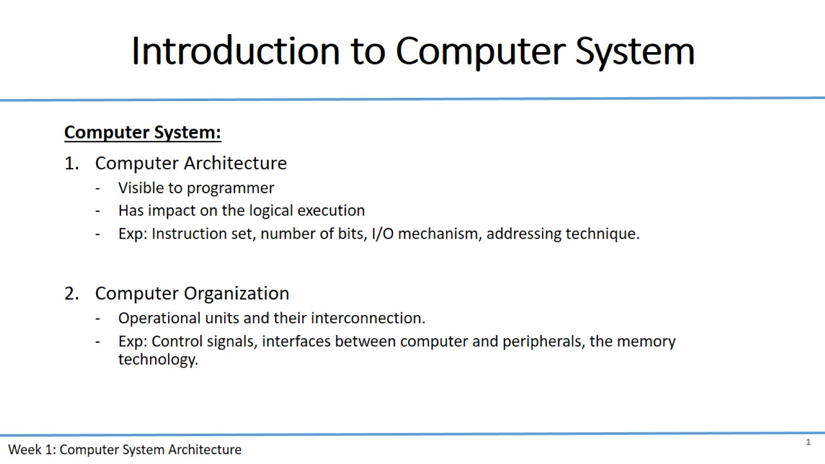
Introduction to Computer System

Slide 2
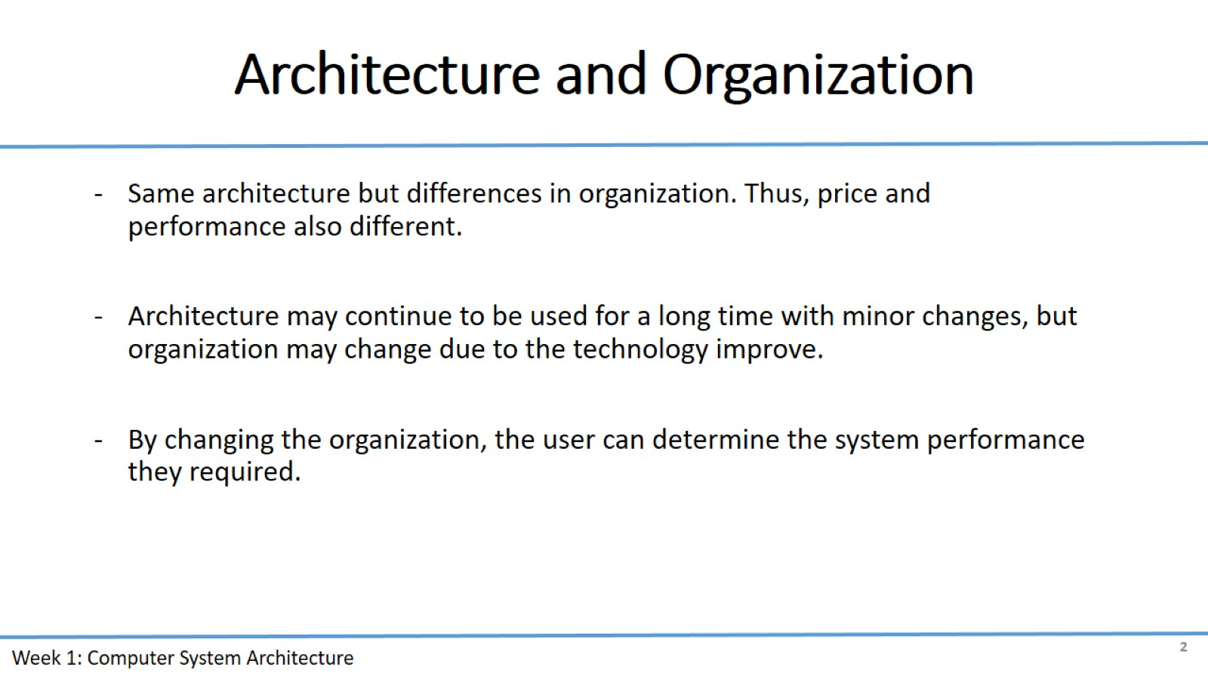
Architecture and Organization

Slide 3
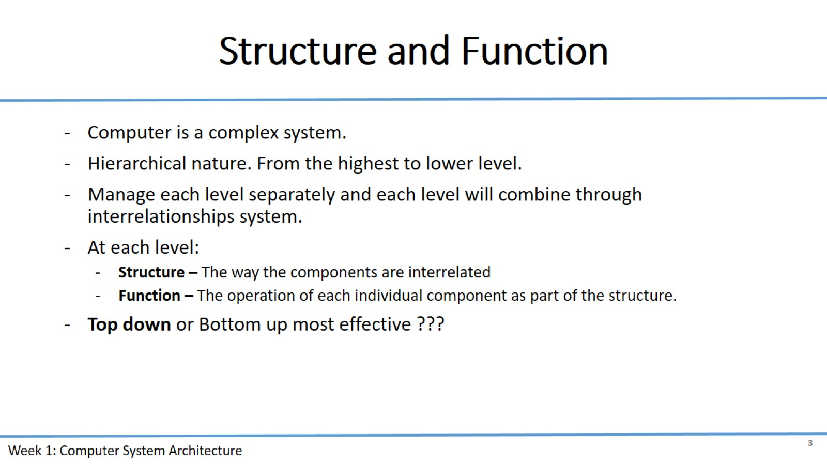
Structure and Function

Slide 4
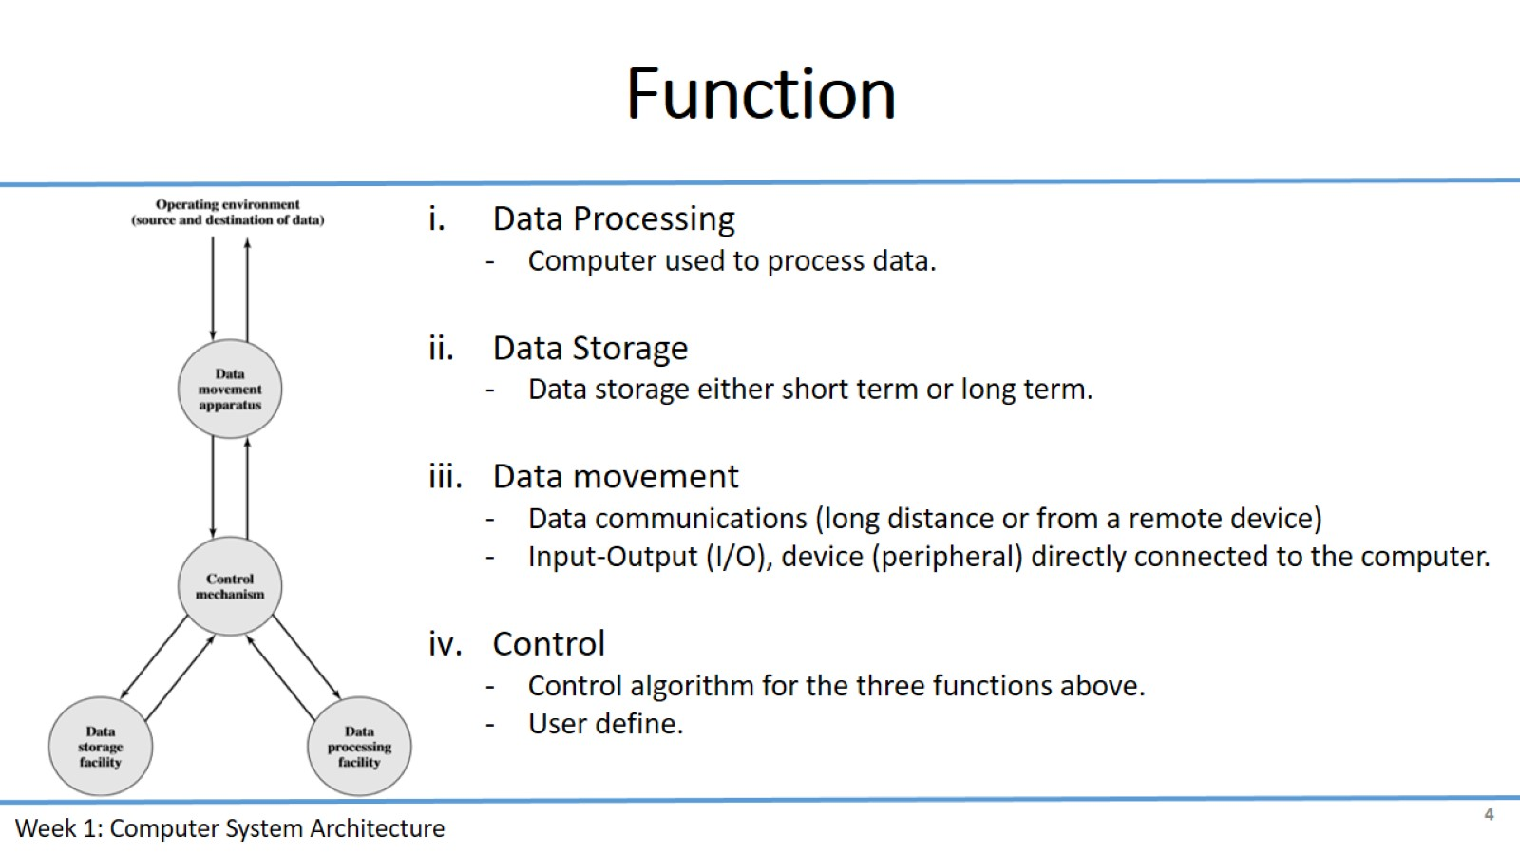
Function

Slide 5
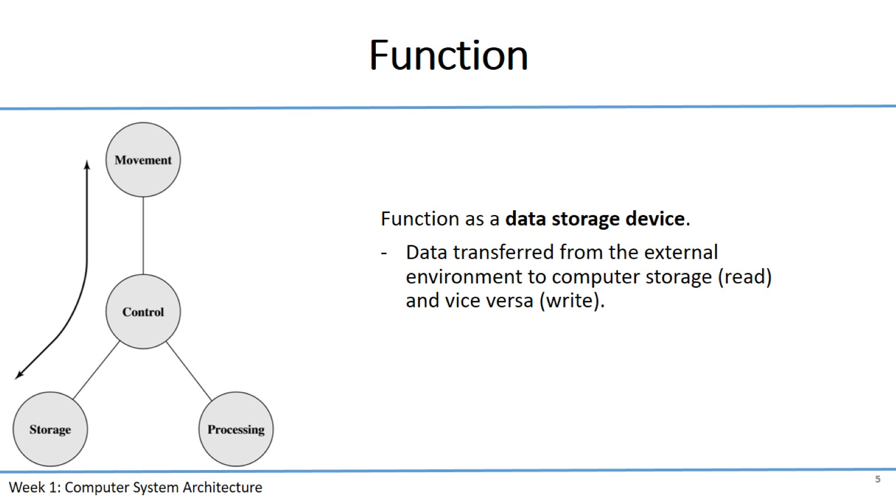
Function

Slide 6
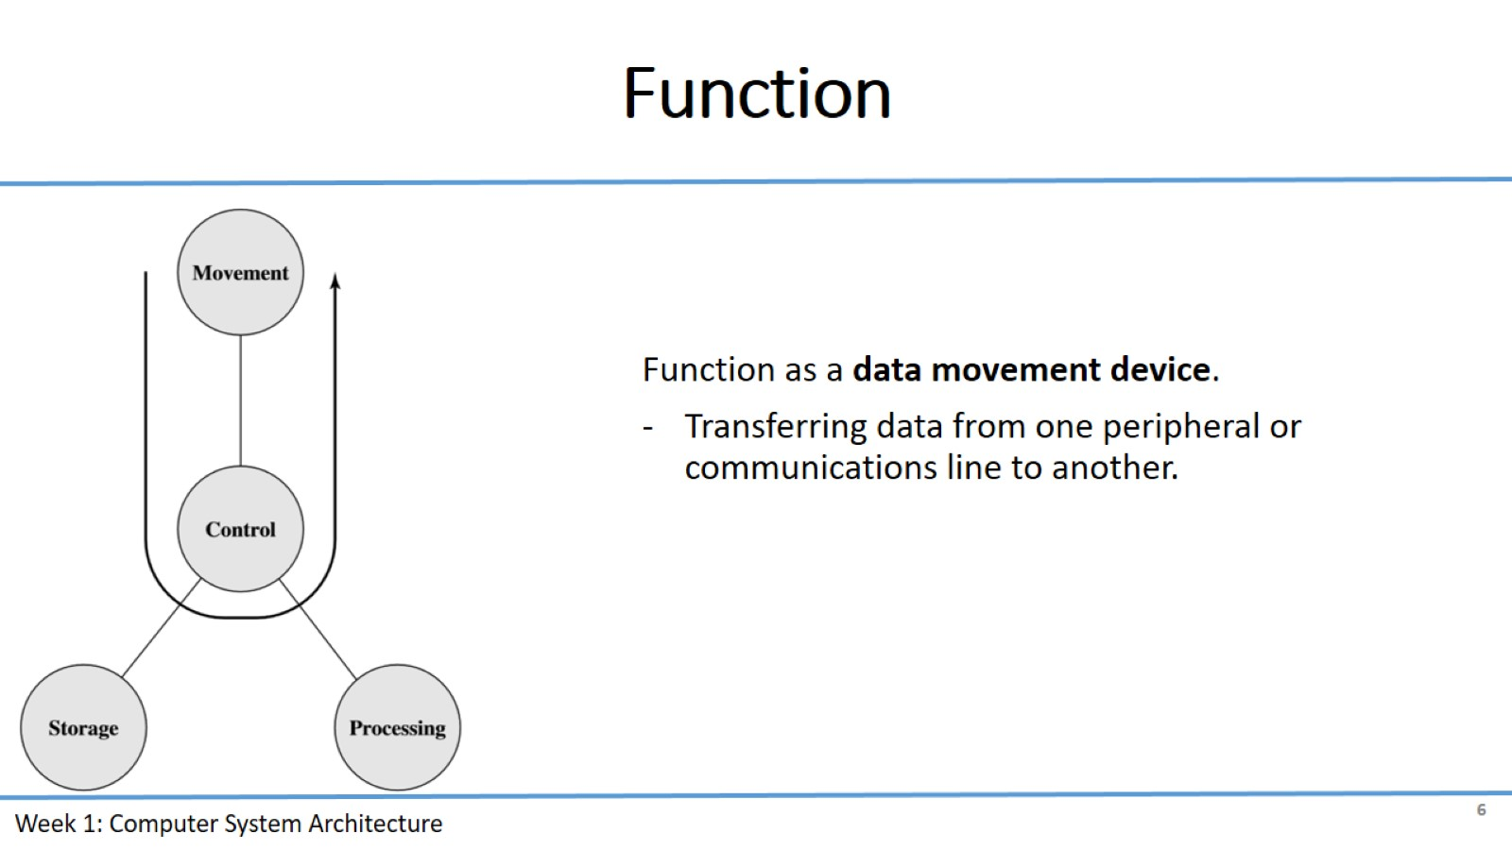
Function

Slide 7
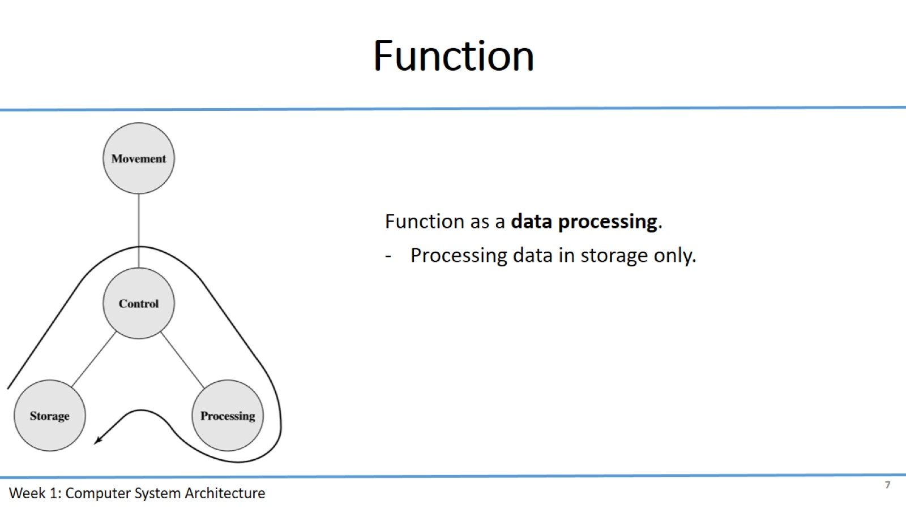
Function

Slide 8
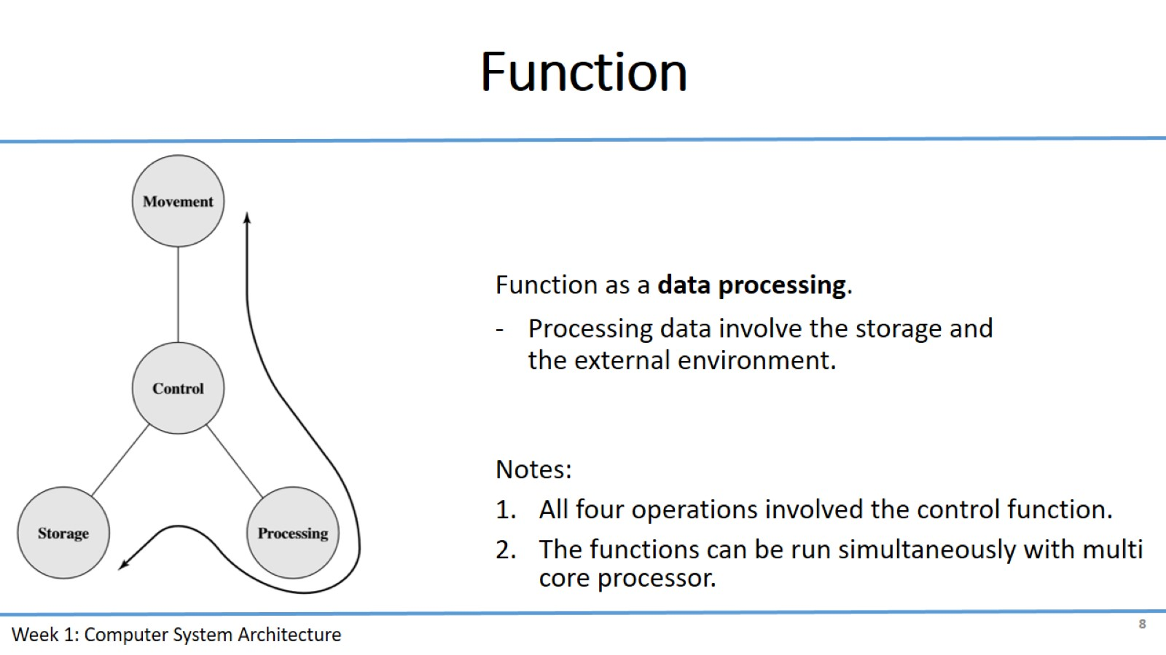
Function

Slide 9
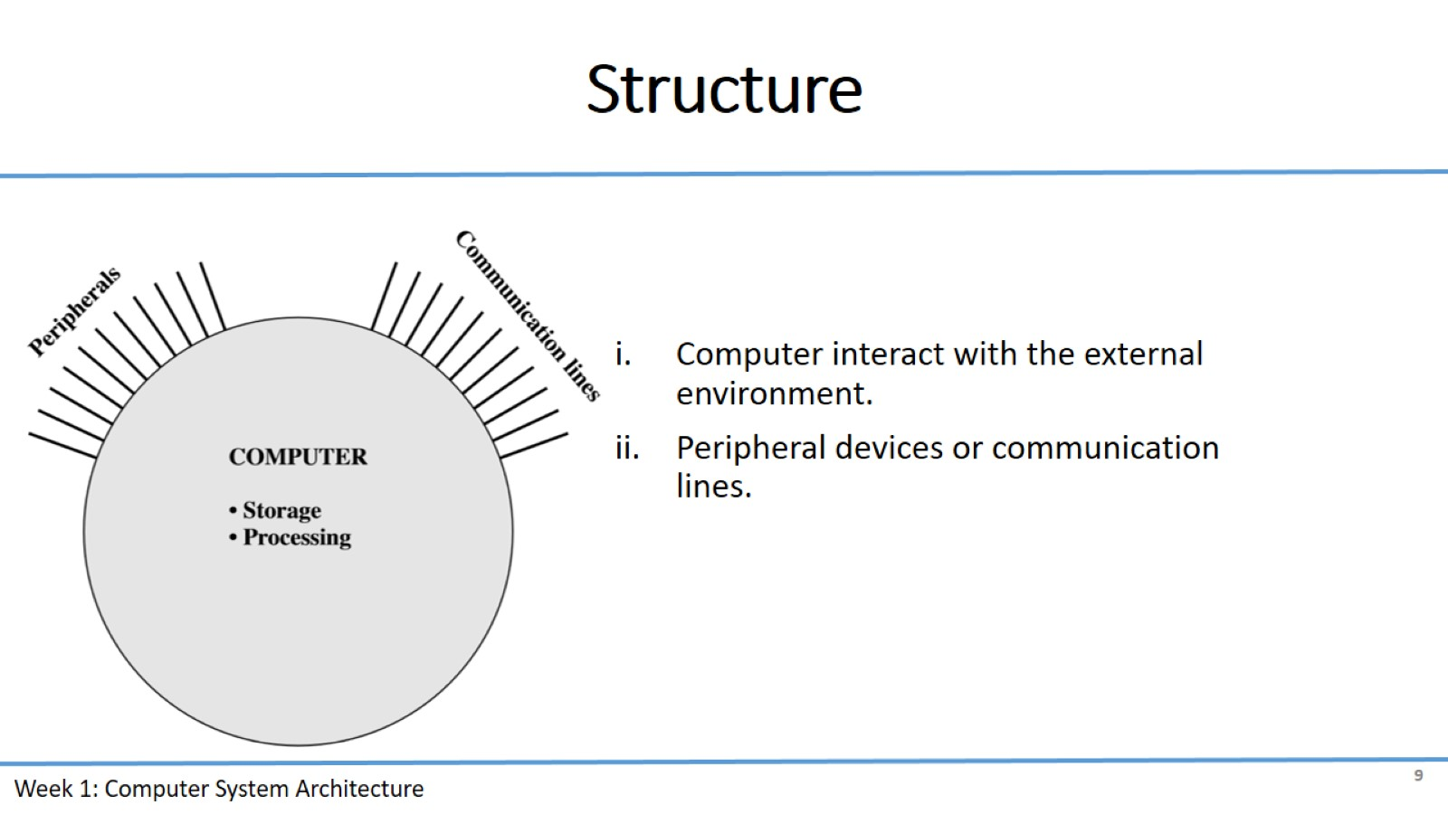
Structure

Slide 10
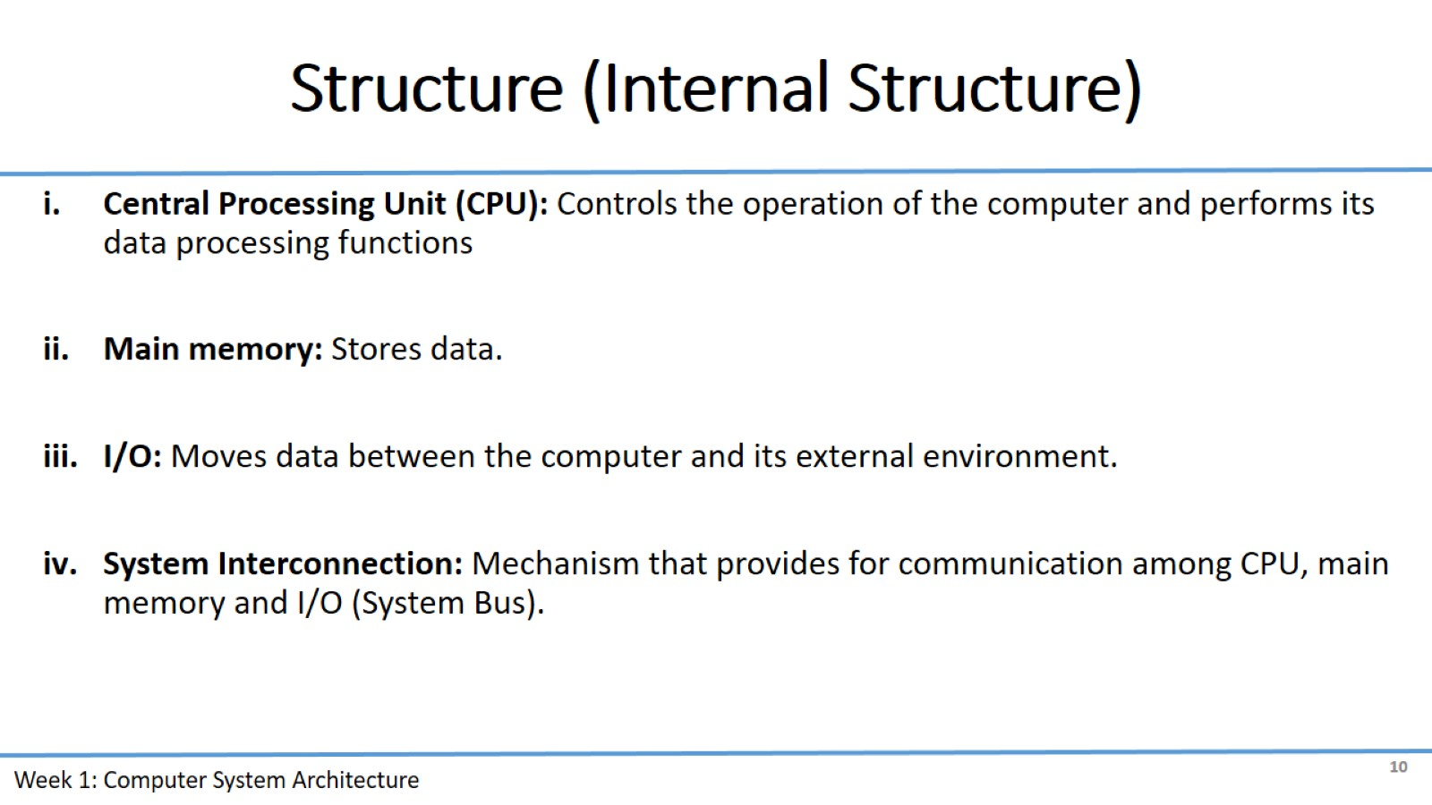
Structure (Internal Structure)

Slide 11
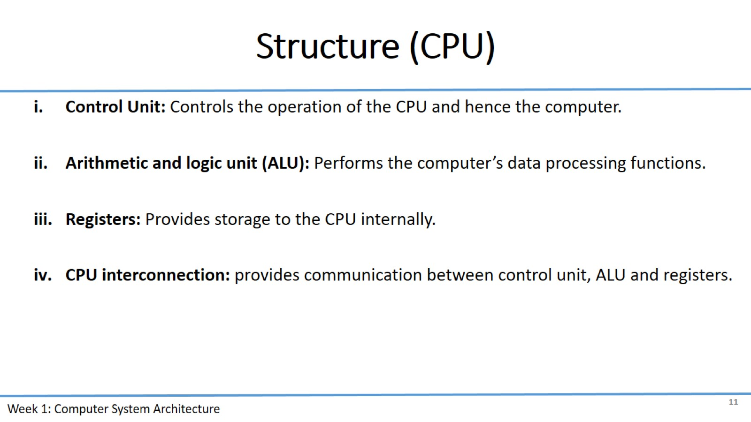
Structure (CPU)

Slide 12
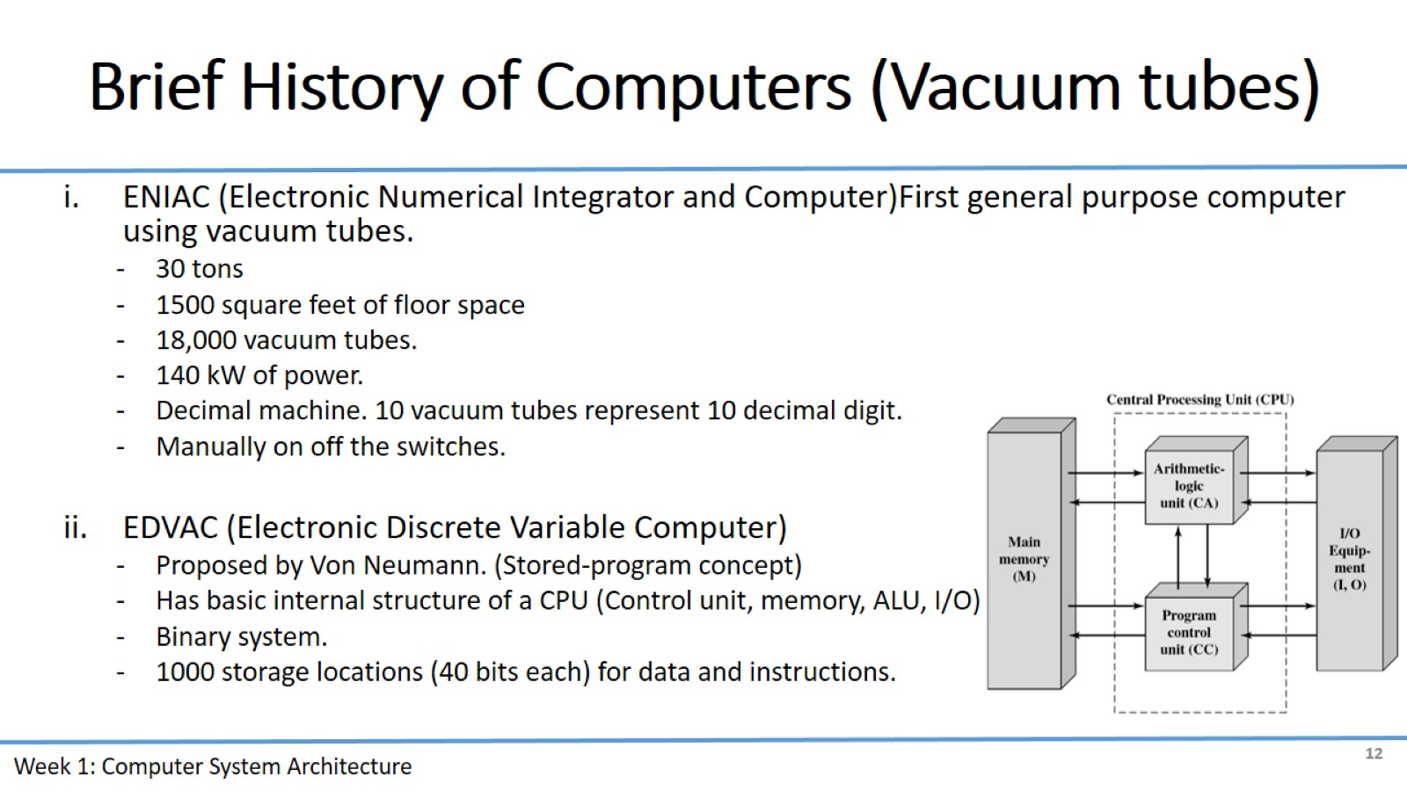
Brief History of Computers (Vacuum tubes)

Slide 13
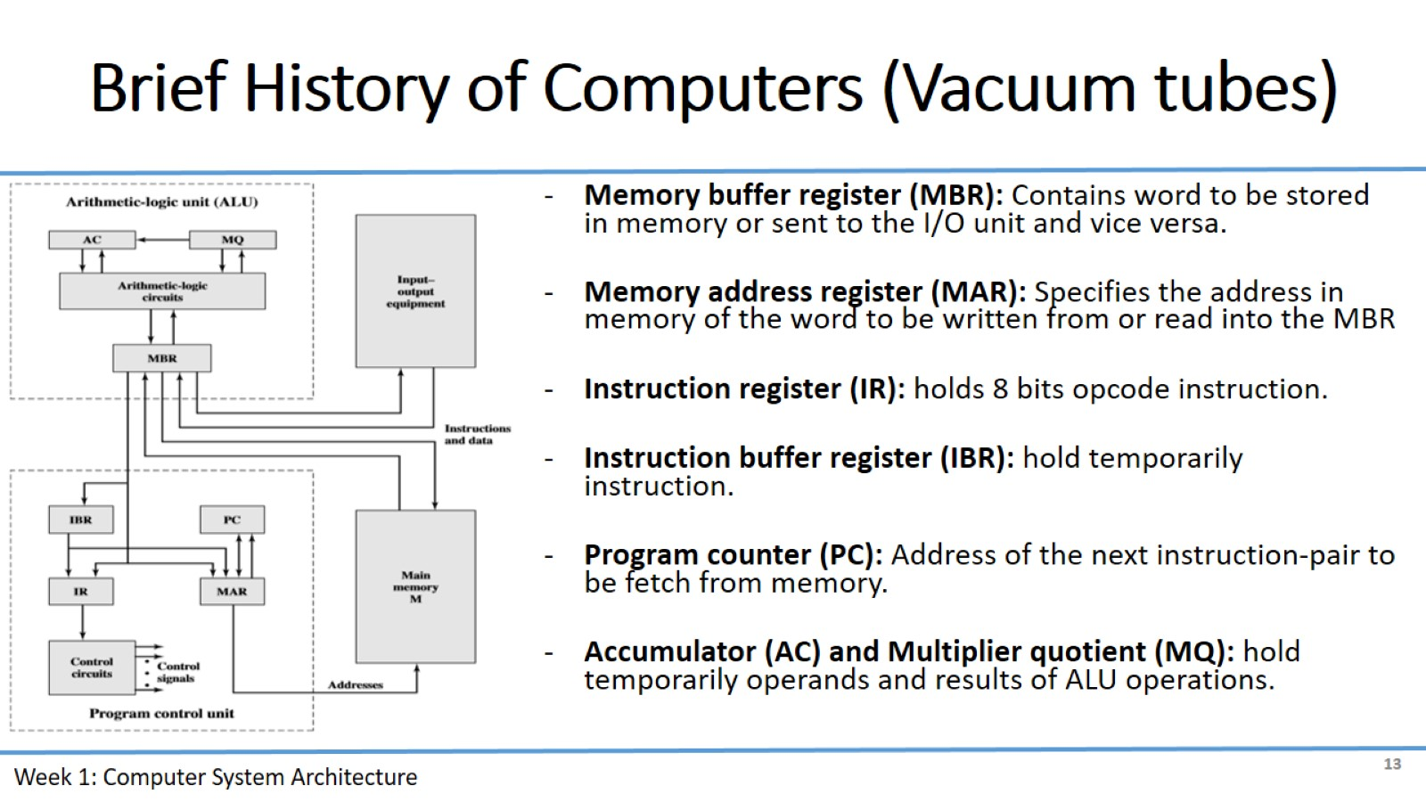
Brief History of Computers (Vacuum tubes)

Slide 14
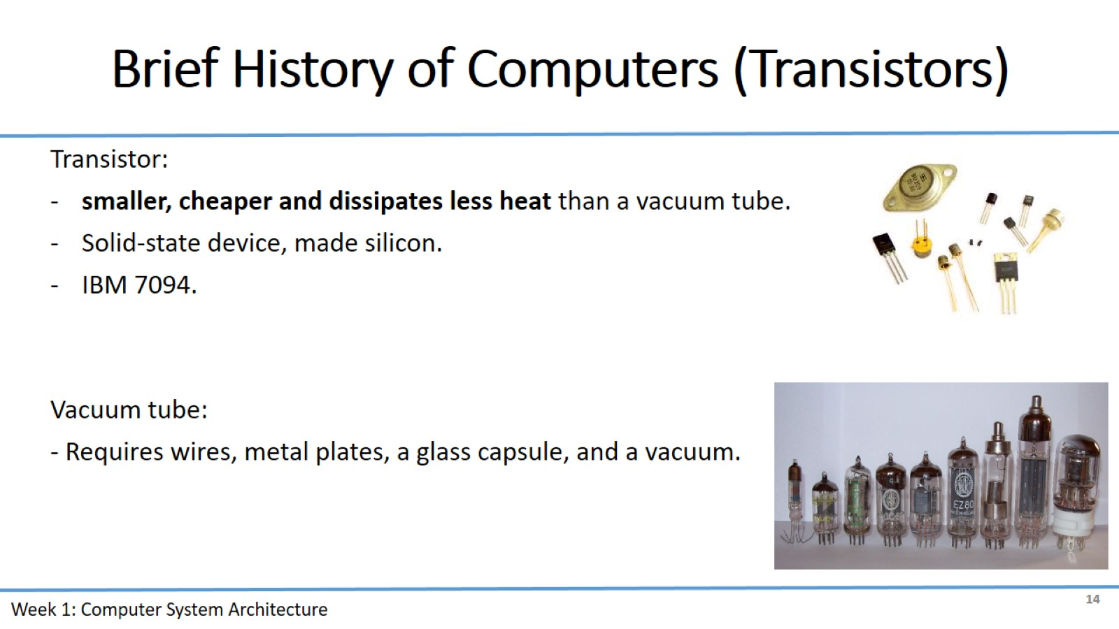
Brief History of Computers (Transistors)

Slide 15
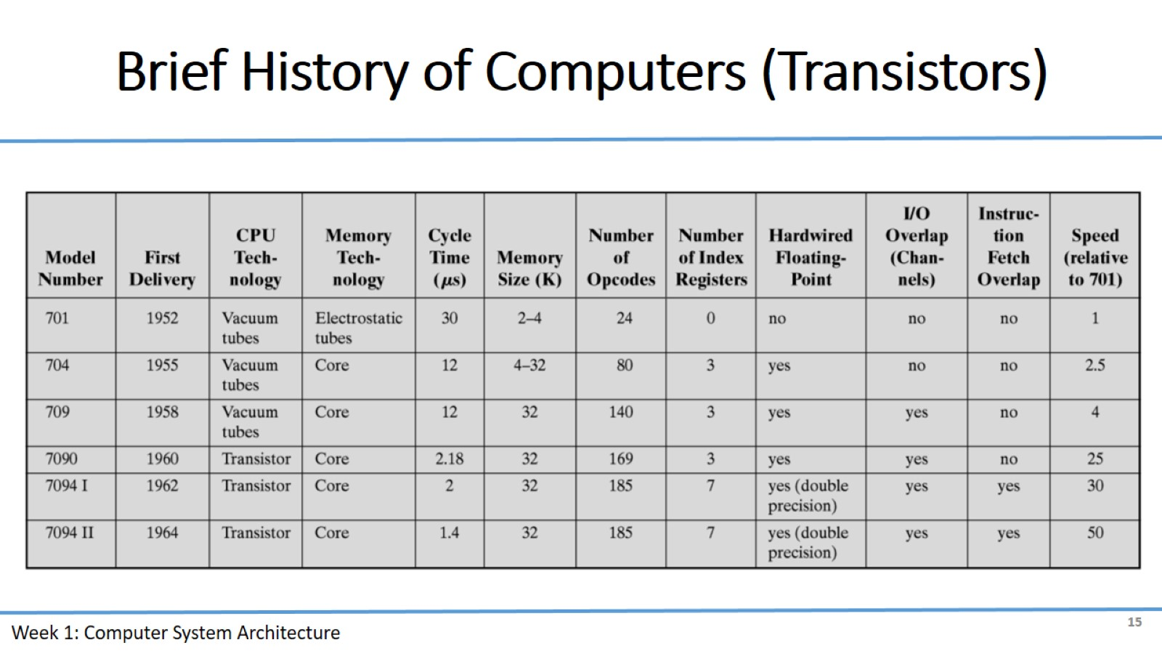
Brief History of Computers (Transistors)

Slide 16
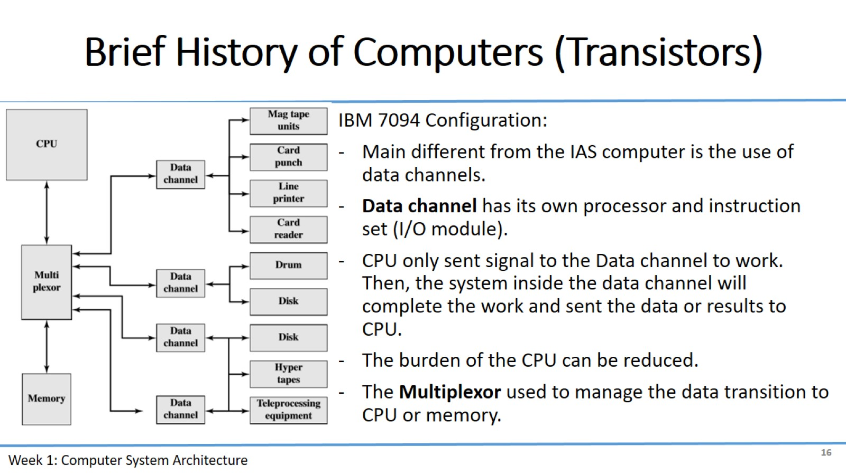
Brief History of Computers (Transistors)

Slide 17
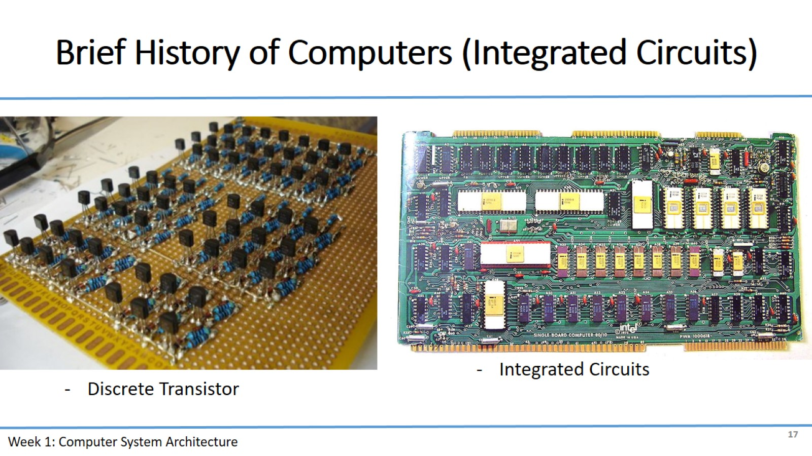
Brief History of Computers (Integrated Circuits)

Slide 18
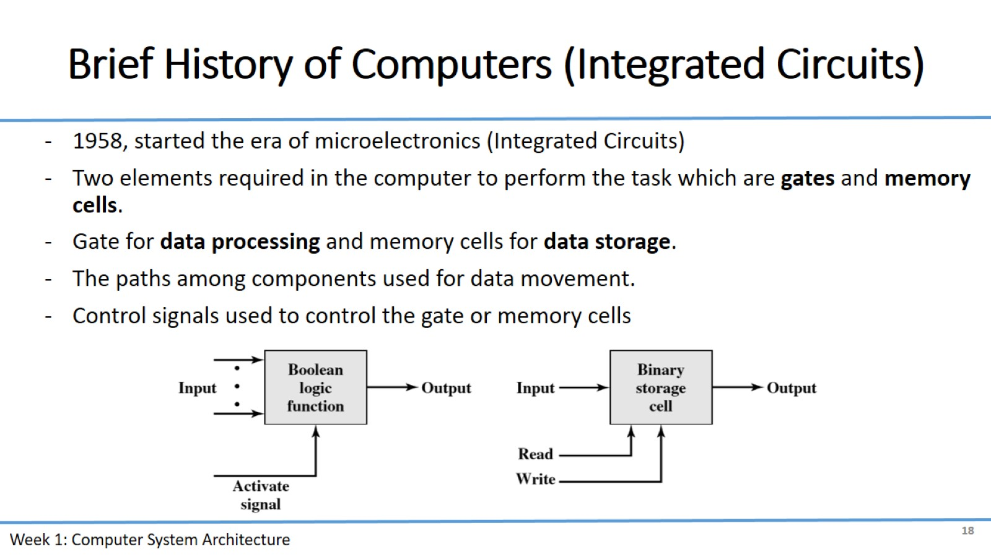
Brief History of Computers (Integrated Circuits)

Slide 19
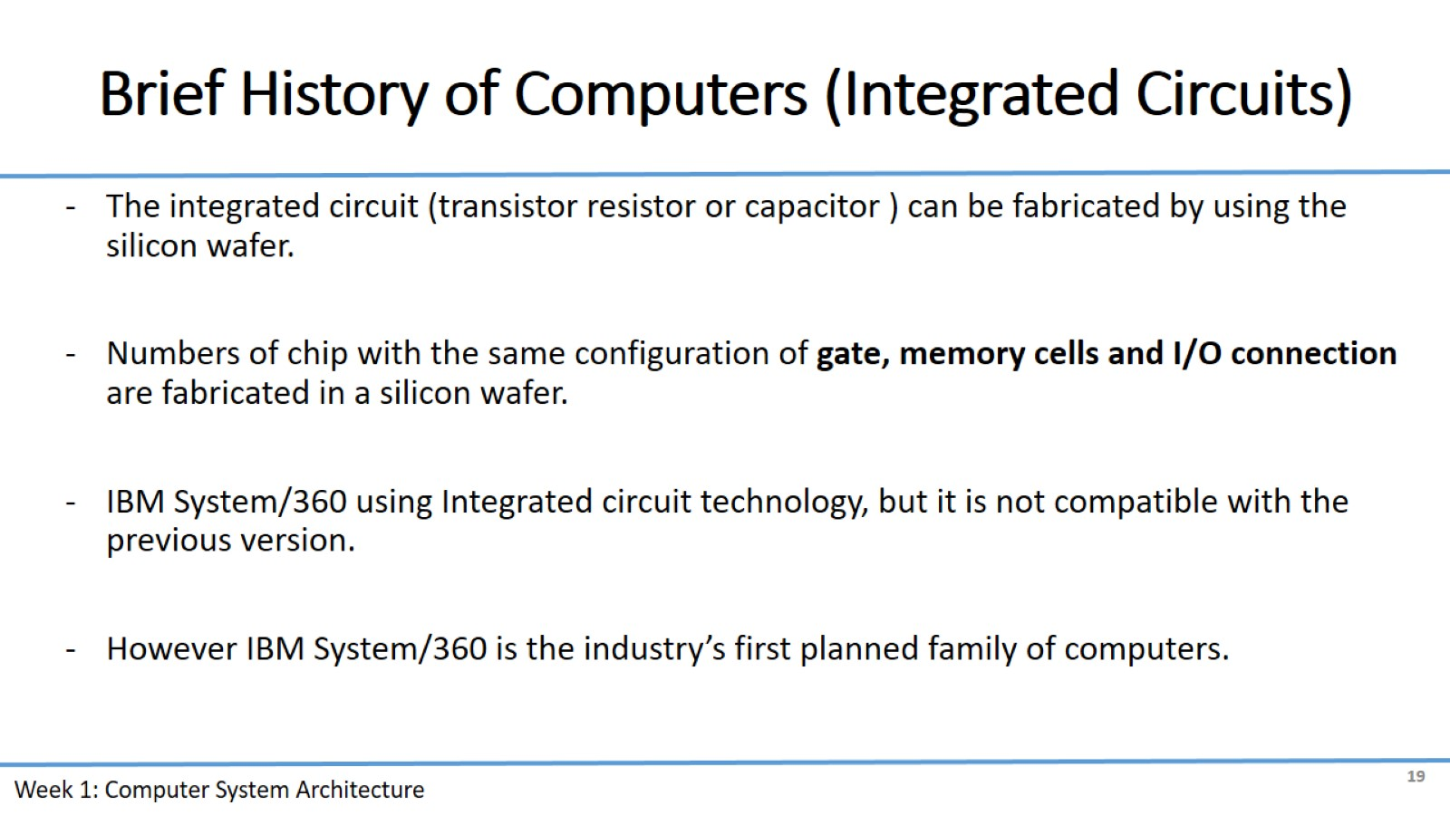
Brief History of Computers (Integrated Circuits)

Slide 20
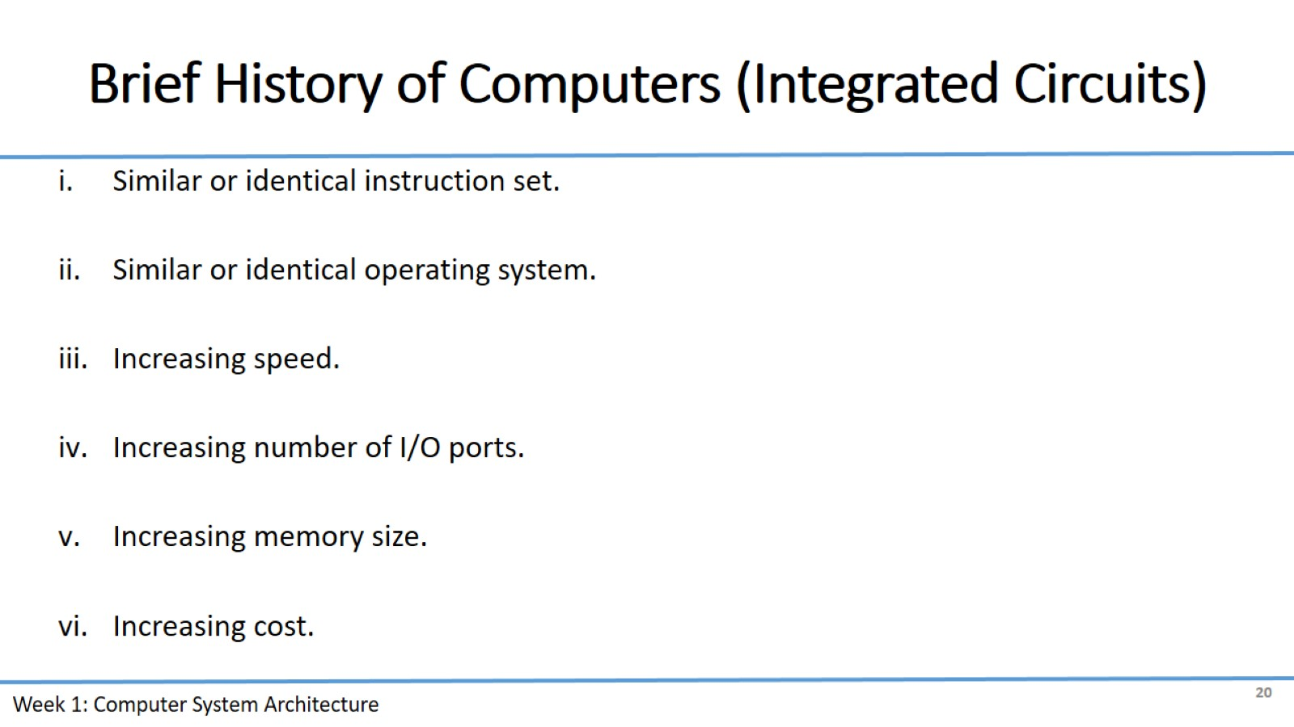
Brief History of Computers (Integrated Circuits)

Slide 21
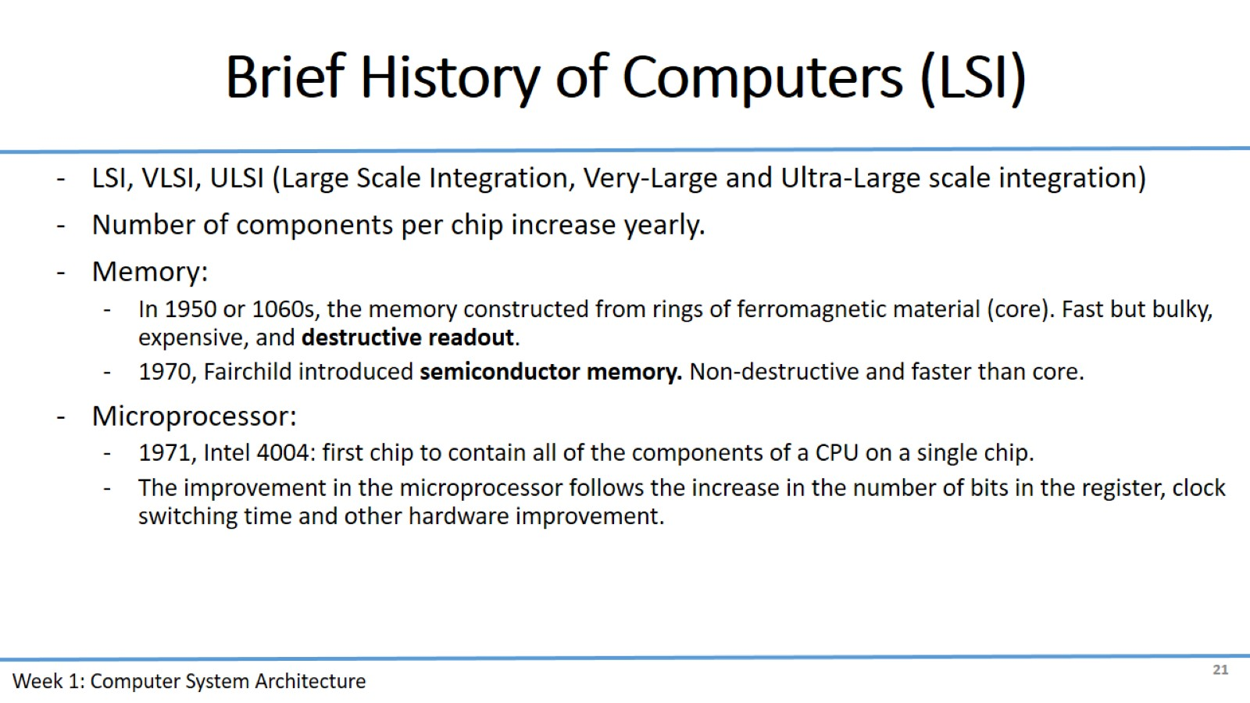
Brief History of Computers (LSI)

Slide 22
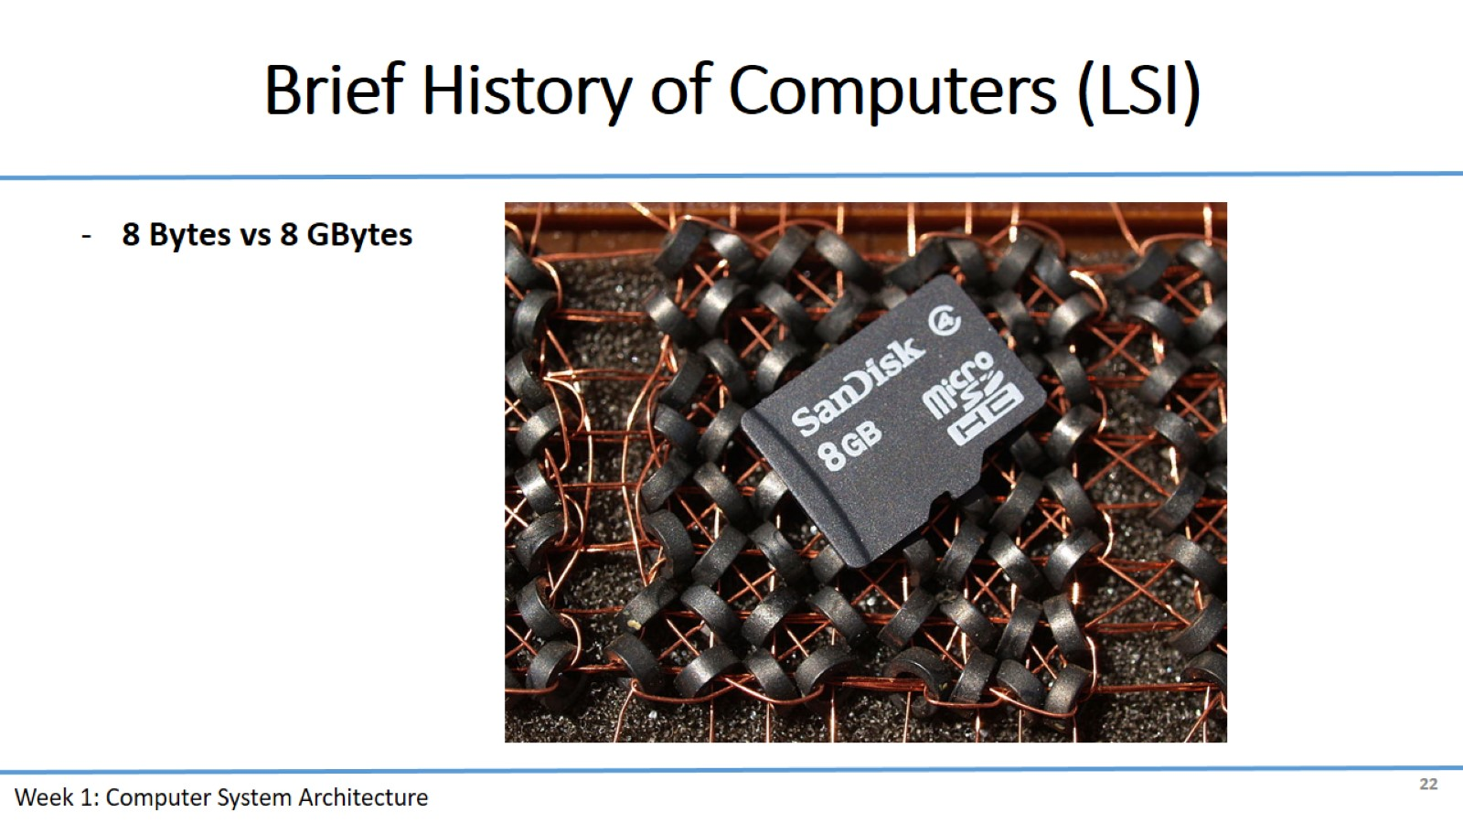
Brief History of Computers (LSI)

